Slide 1




Why metagenomics is broken
slides: goo.gl/xxxxx
@MadsAlbertsen85
Mads Albertsen, PhD student
Søren M. Karst, Rasmus H. Kirekegaard & Per H. Nielsen
Center for Microbial Communities
CAMI
25-08-2014
ISME15, Soul, South Korea

Slide 2


Critical Assesment of Metagenome Interpretation
Showcase potentials and limitations
www.cami-challenge.org
Center for Microbial Communities | Aalborg University

Slide 3
Critical Assesment of Metagenome Interpretation
Showcase potentials and limitations
The implication of lack of reference genomes on
taxonomic classification
The impact of micro-diversity on
assembly and
genome completeness metrics
More visualisations, please.
www.cami-challenge.org
Center for Microbial Communities | Aalborg University

Slide 4
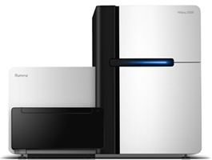
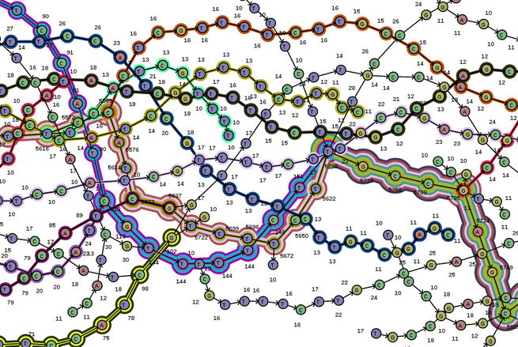
Sequence
Assemble
Compare to database
(BLAST vs. NCBI RefSeq)
Taxonomic Classification
(MEGAN)
Center for Microbial Communities | Aalborg University

Slide 5
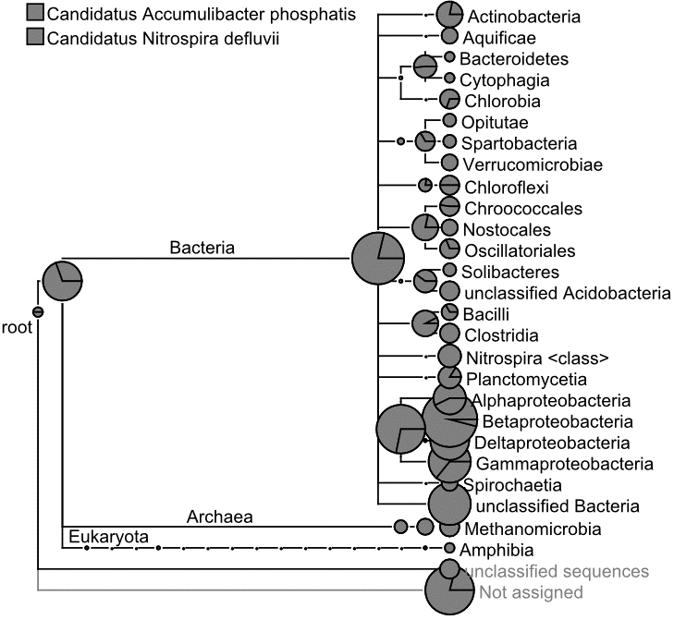
Center for Microbial Communities | Aalborg University

Slide 6
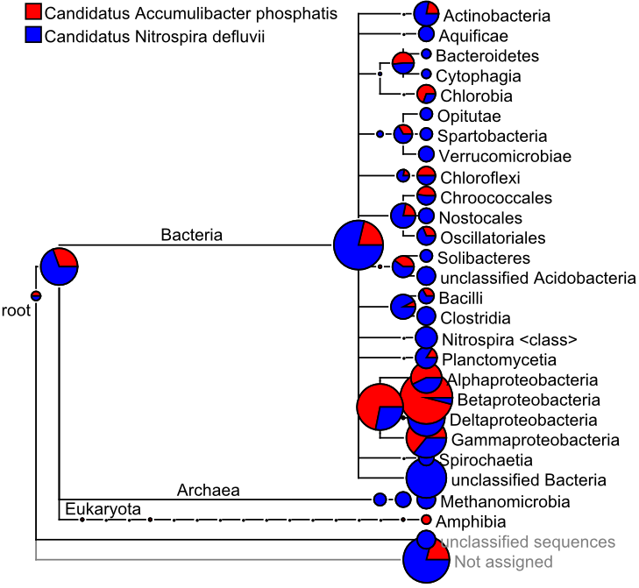
The simplest metagenome in the world
Accumulibacter (Class Betaproteobacteria)
Nitrospira (Class Nitrospira)
Center for Microbial Communities | Aalborg University

Slide 7

The simplest metagenome in the world
99%
Abundance (%)
50%
50%
1 %
Reads
Assembly
Remember to correct for read abundance
Accumulibacter (Class Betaproteobacteria)
Nitrospira (Class Nitrospira)
Center for Microbial Communities | Aalborg University

Slide 8
Assembly
... of the simplest metagenome in the world
Visualisation: Ray Cloud Browser (S. Boisvert)
Center for Microbial Communities | Aalborg University

Slide 9
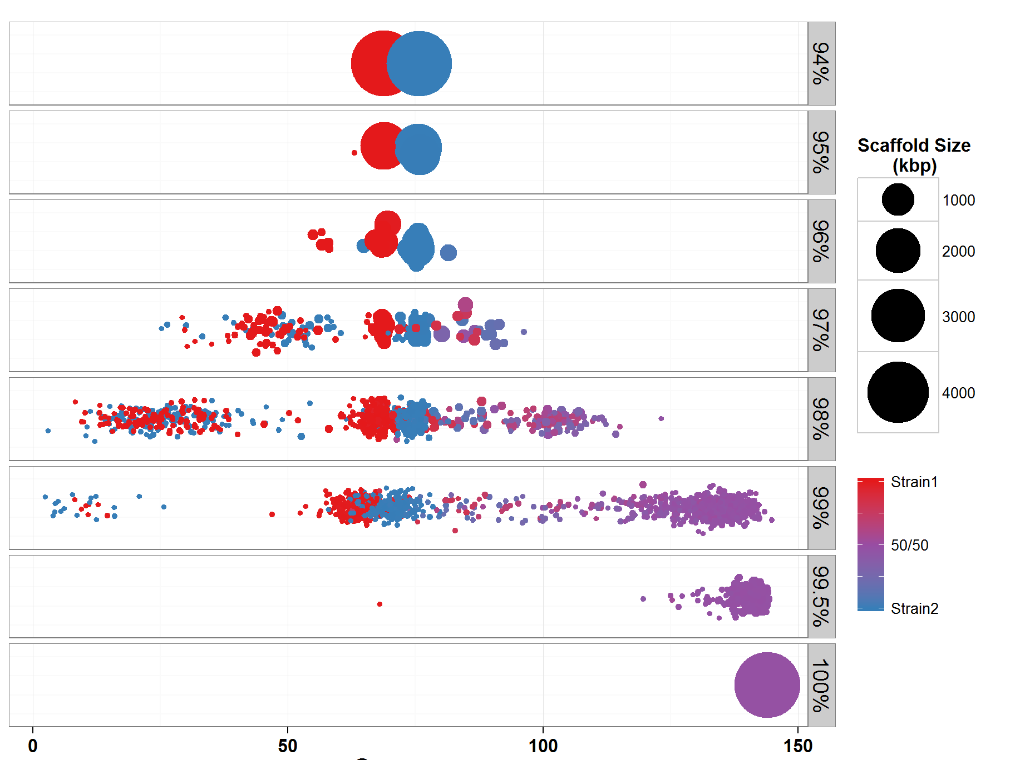
ANI
Coverage (Abundance)
Reads: 2x250 bp MiSeq
Assembly: CLC [kmer 64]
Center for Microbial Communities | Aalborg University

Slide 10
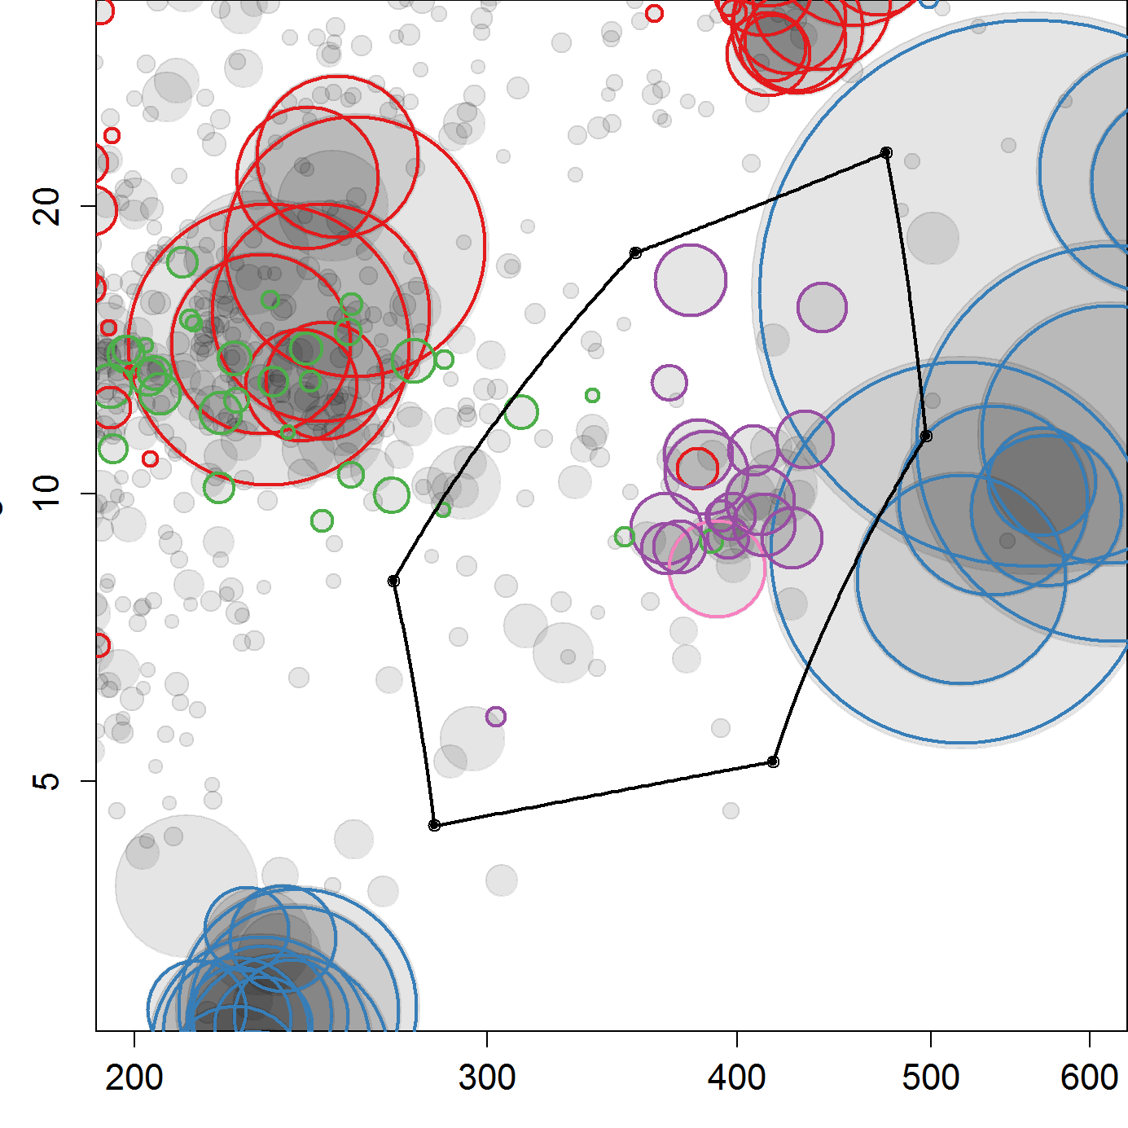
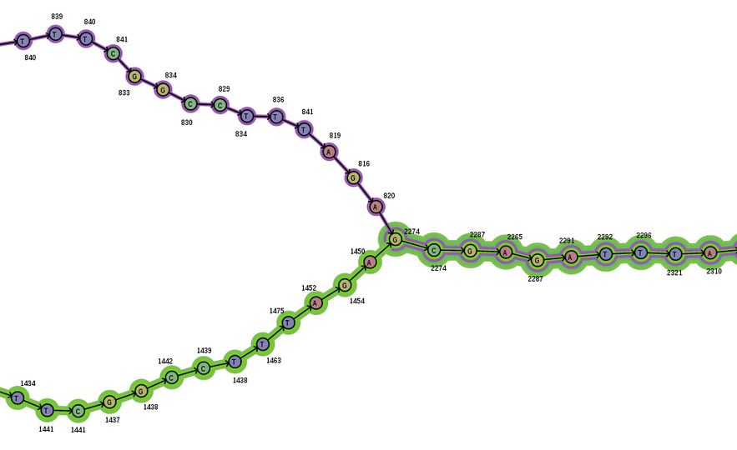
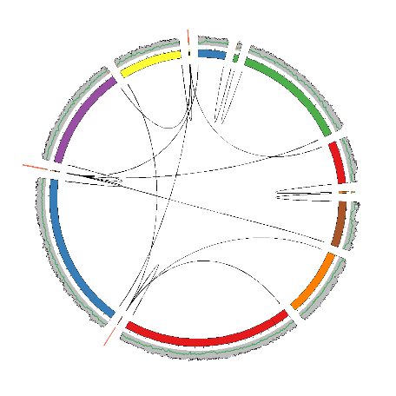
Sequencing
Assembly
Genome Binning
Re-assembly
Manual curation
Center for Microbial Communities | Aalborg University

Slide 11
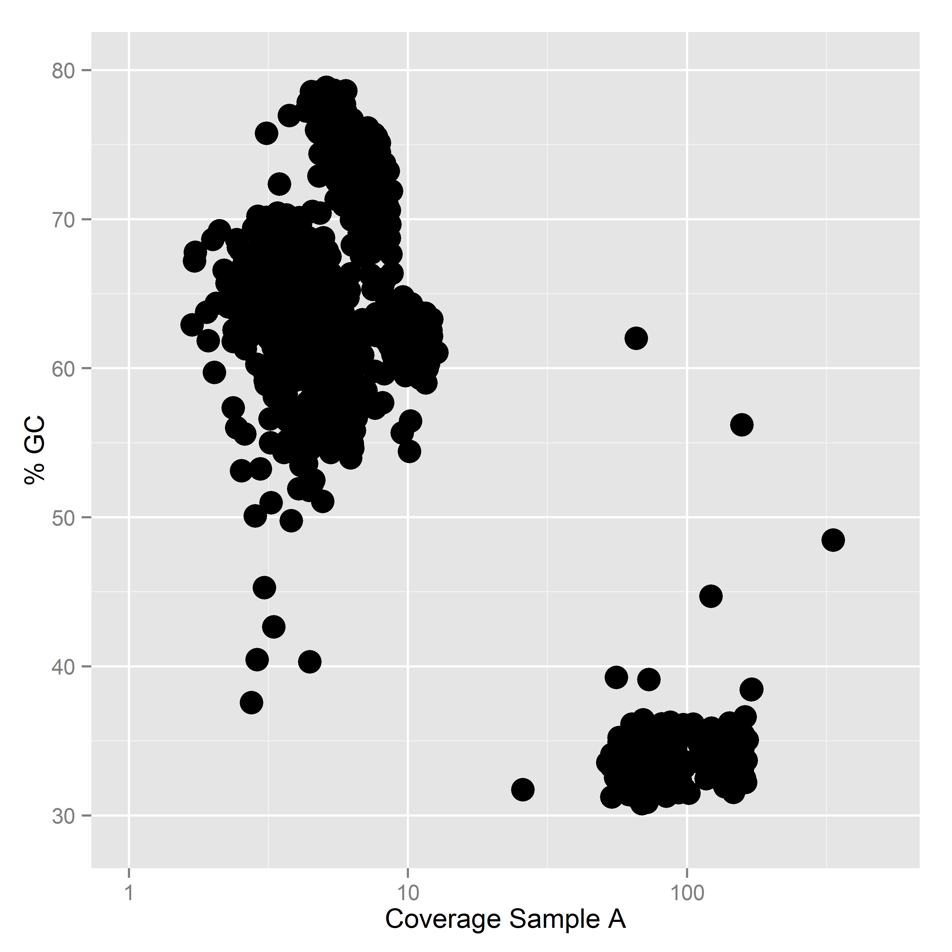
L. Sauder & J. Neufield, University of Waterloo (in prep)
Center for Microbial Communities | Aalborg University

Slide 12
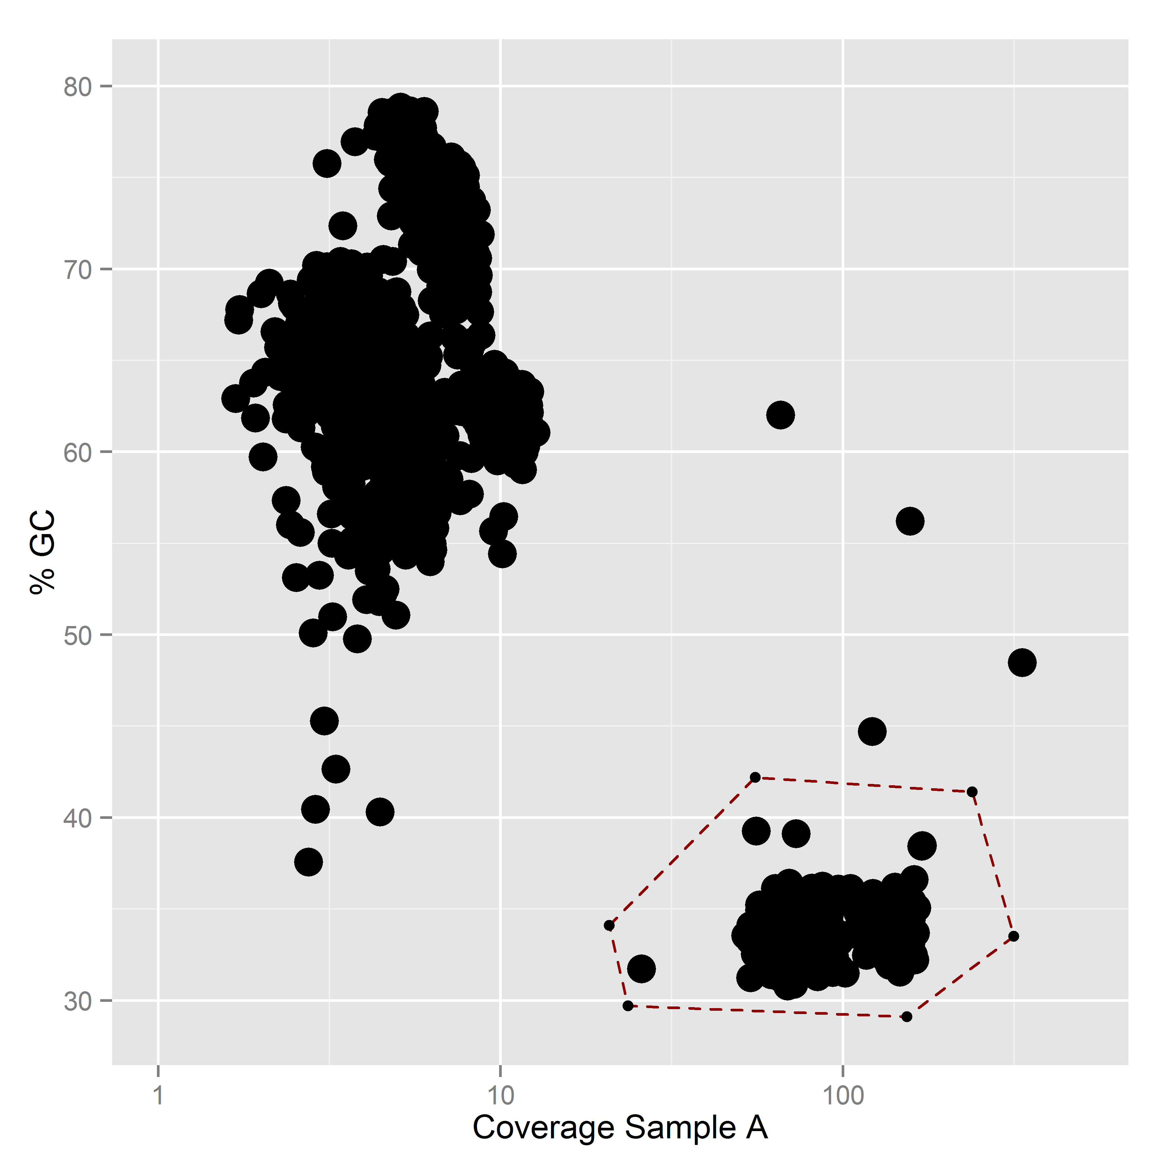
Assembly statistics
# Scaffolds | 447
Total Mbp | 4.46
% GC | 33.7
N50 | 22281
Essential genes | 31/29
High-quality draft genome by HMP standards
L. Sauder & J. Neufield, University of Waterloo (in prep)
Center for Microbial Communities | Aalborg University

Slide 13
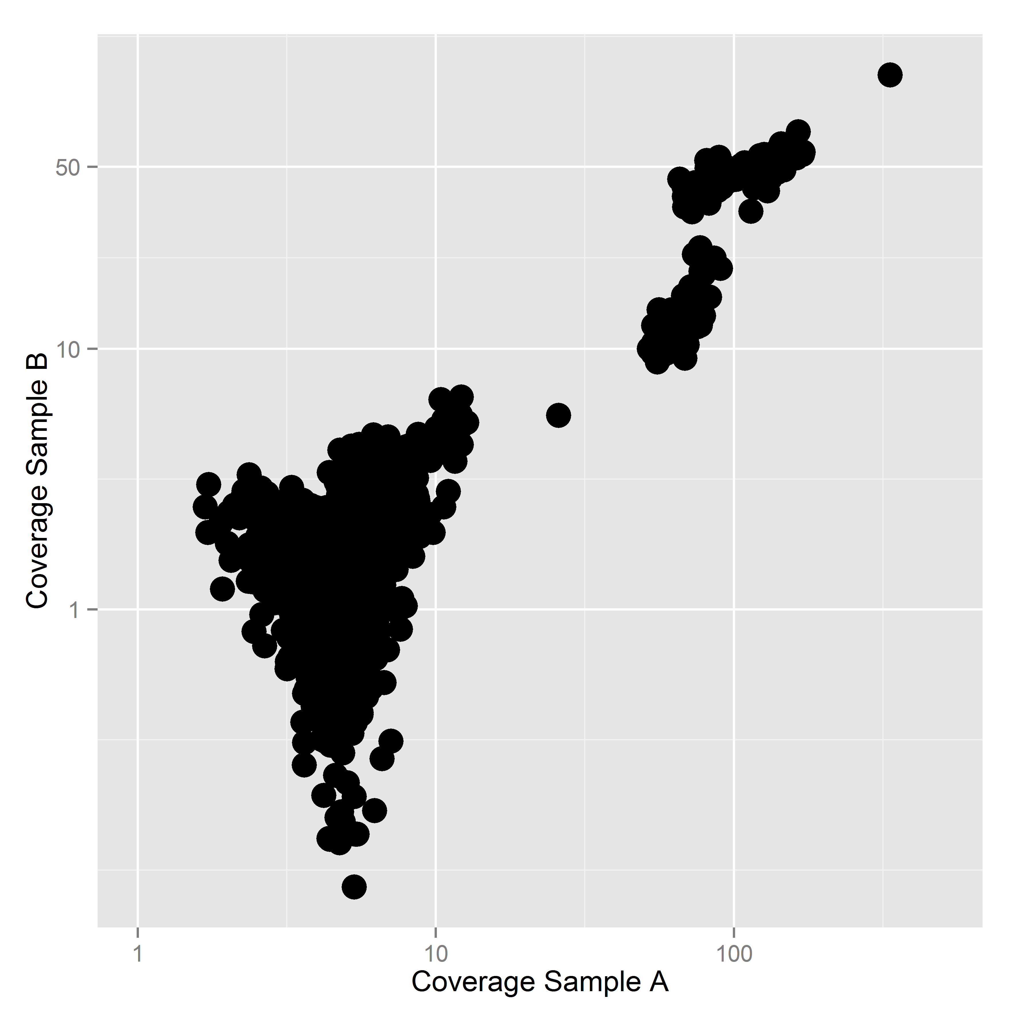
L. Sauder & J. Neufield, University of Waterloo (in prep)
Center for Microbial Communities | Aalborg University

Slide 14
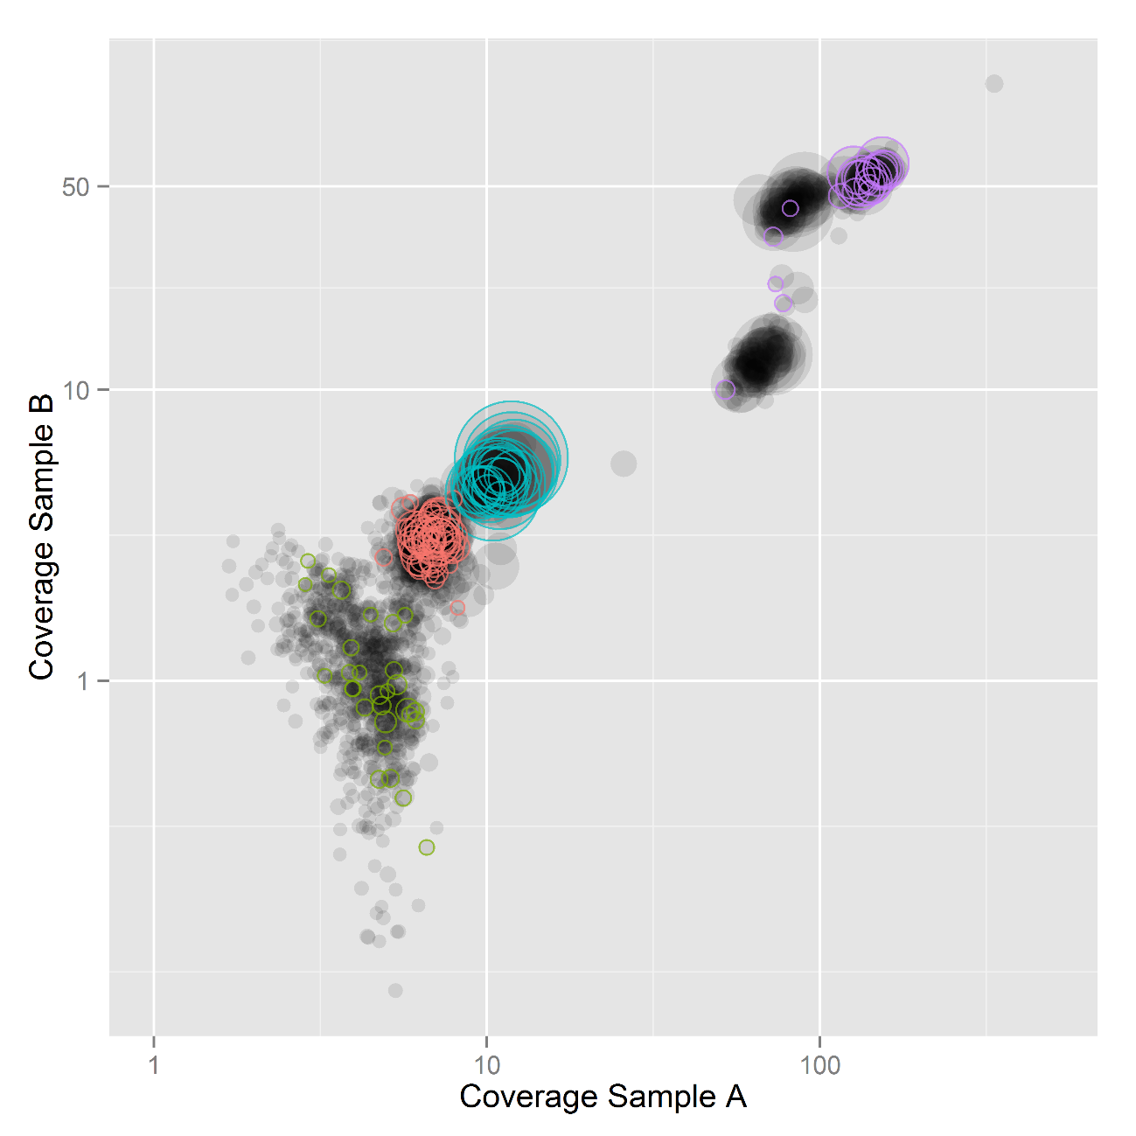
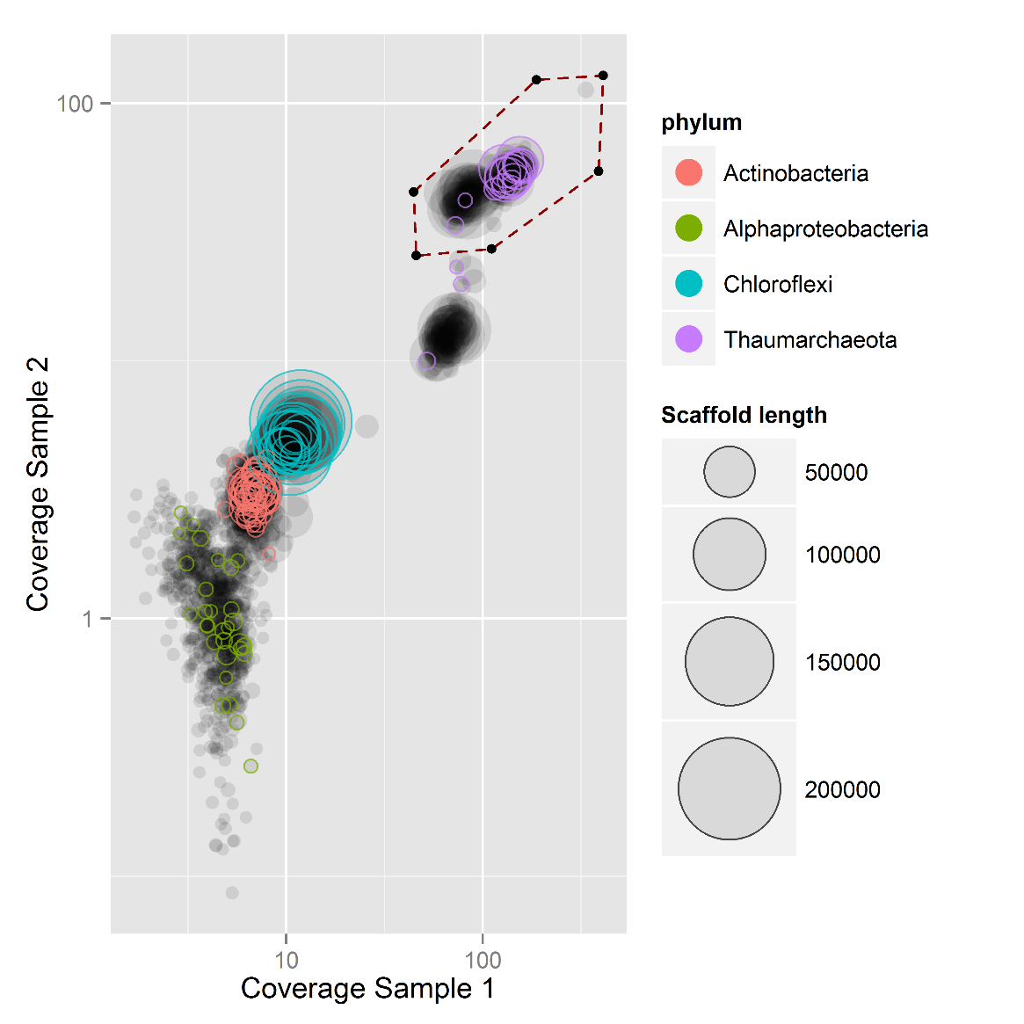
Taxonomic classification
of essential genes
Scaffold Length
L. Sauder & J. Neufield, University of Waterloo (in prep)
Center for Microbial Communities | Aalborg University

Slide 15
B
Taxonomic classification
of essential genes
A
C
Scaffold Length
High-quality draft genome by HMP standards
 | All | A | B | C
# Scaffolds | 447 | 148 | 135 | 164
Total Mbp | 4.46 | 1.40 | 1.48 | 1.58
% GC | 33.7 | 34.2 | 34.2 | 33.5
N50 | 22281 | 17655 | 27290 | 21230
Essential genes | 31/29 | 26/29 | 2/29 | 3/29
L. Sauder & J. Neufield, University of Waterloo (in prep)
Center for Microbial Communities | Aalborg University

Slide 16
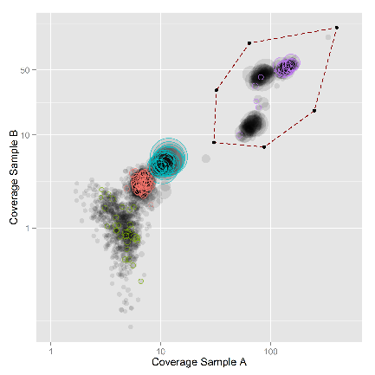
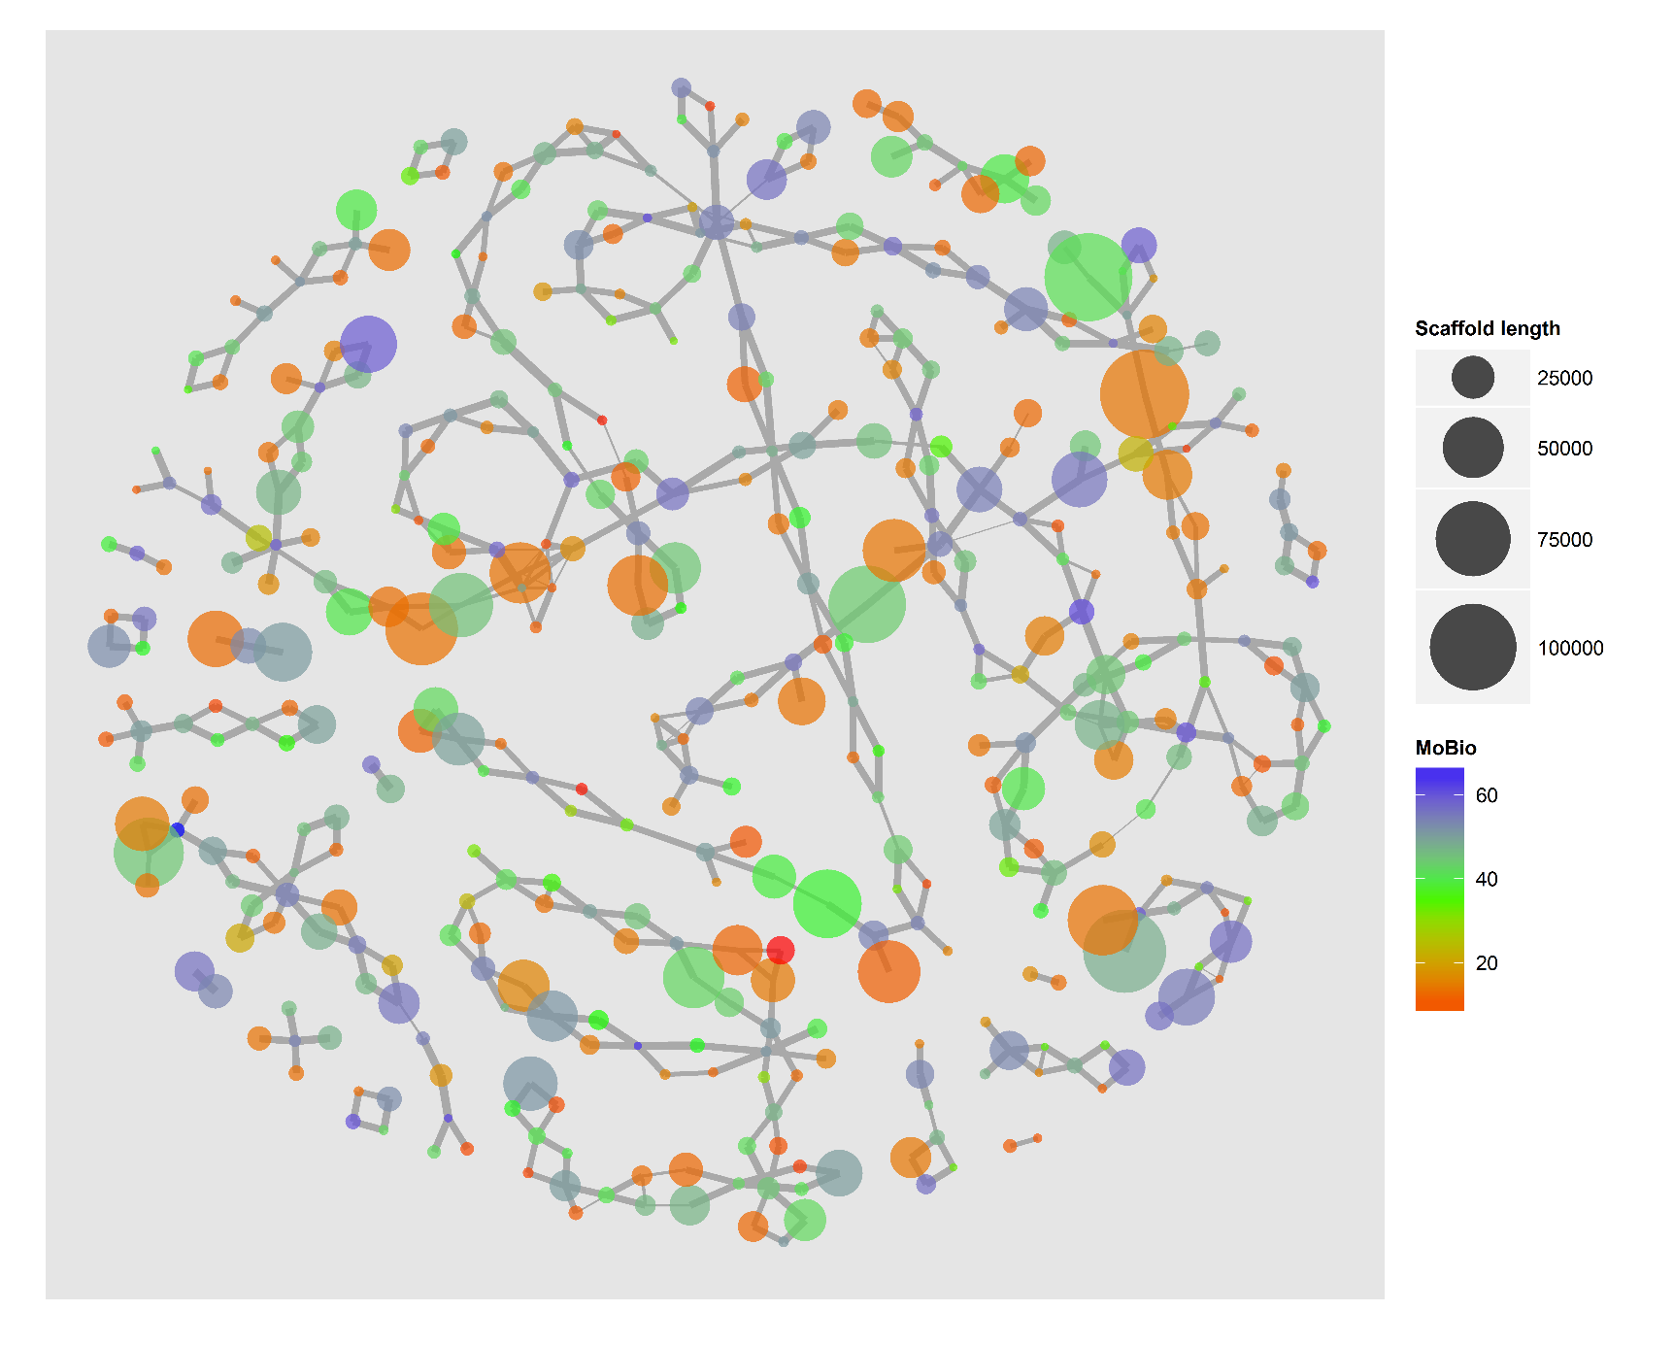
Scaffold Length
Abundance
L. Sauder & J. Neufield, University of Waterloo (in prep)
Center for Microbial Communities | Aalborg University

Slide 17
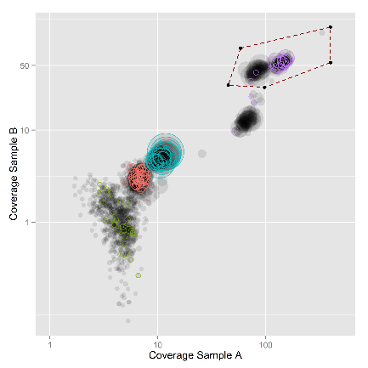
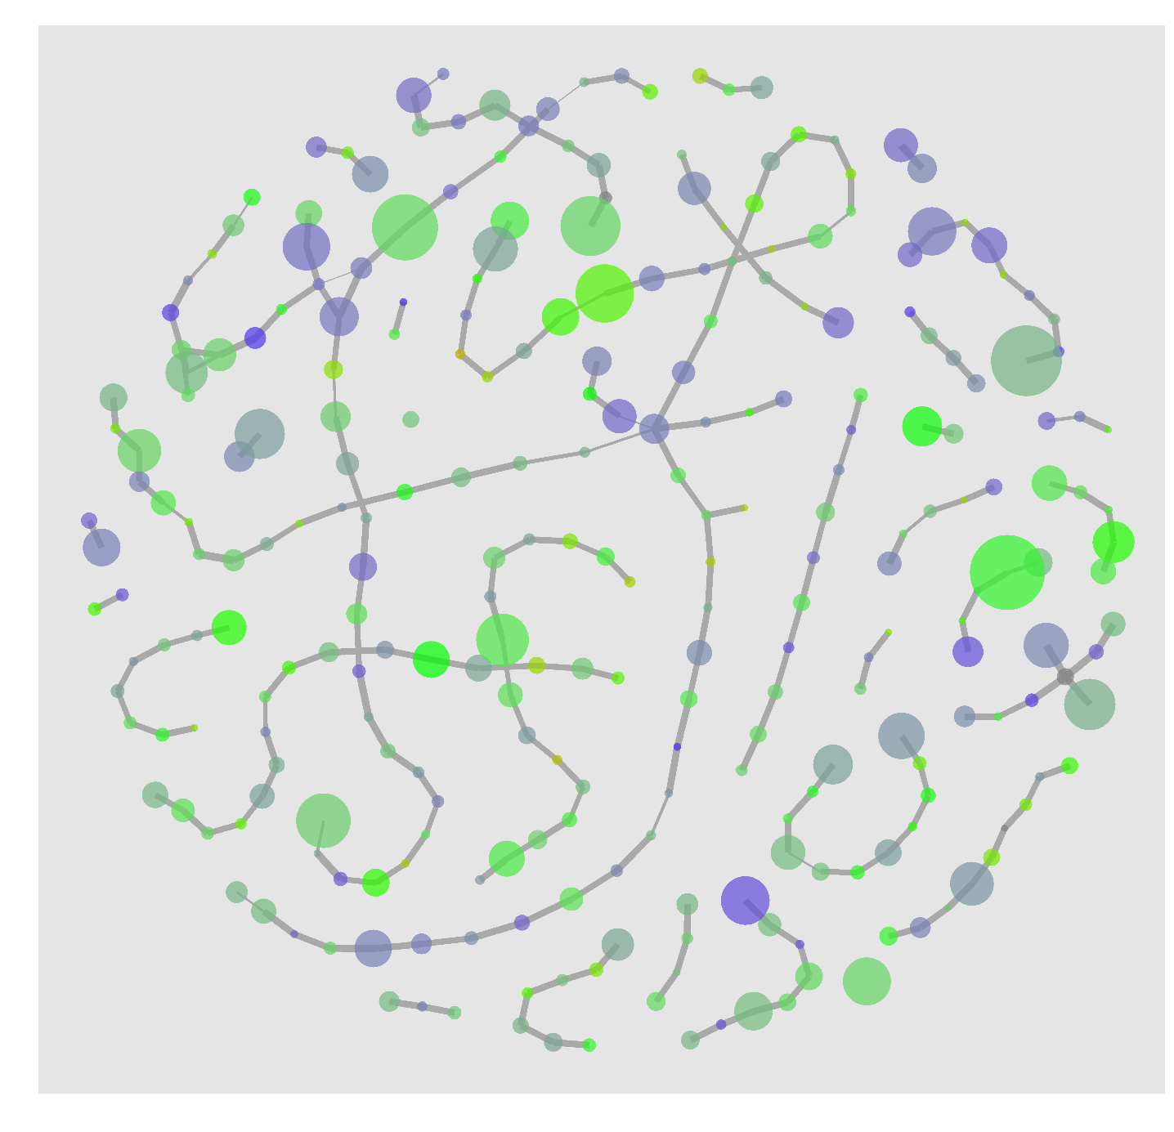
Scaffold Length
Abundance
L. Sauder & J. Neufield, University of Waterloo (in prep)
Center for Microbial Communities | Aalborg University

Slide 18
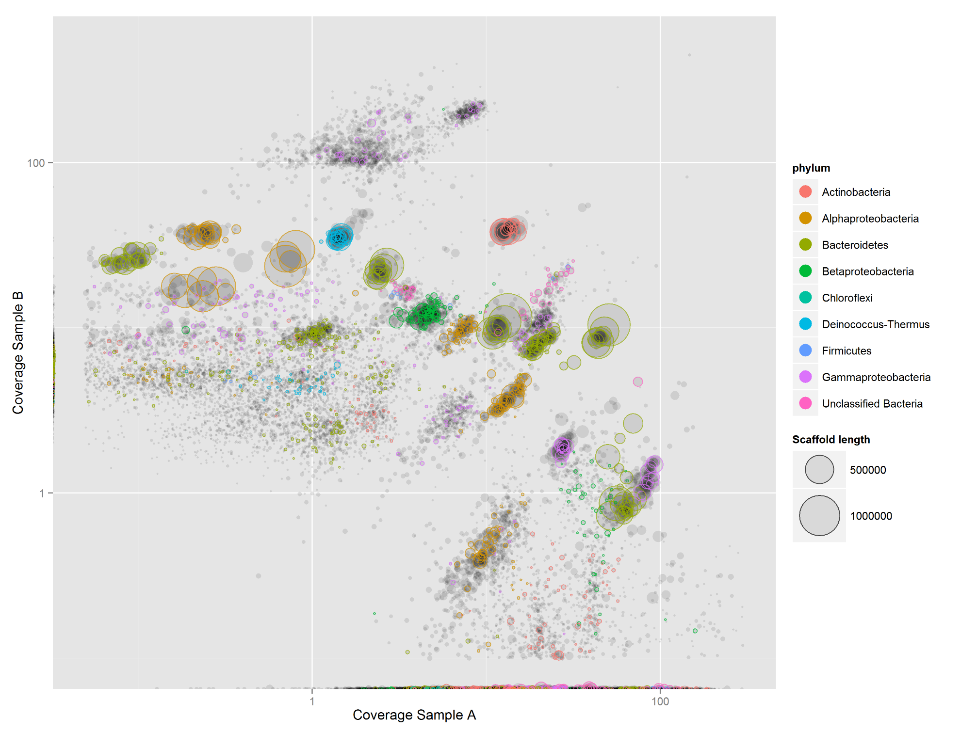


Example dataset in the R package
Center for Microbial Communities | Aalborg University

Slide 19

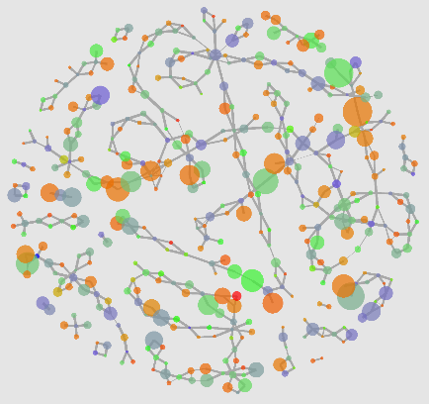
Tetranucleotide frequencies
Abundance in different samples
% GC
Read connections to other scaffolds
Length
Scaffold
In situ proximity
Taxonomic classification
Presence of key genes
or pathways
Center for Microbial Communities | Aalborg University

Slide 20

mmgenome
A toolbox for reproducible genome extraction from metagenomes
MadsAlbertsen/mmgenome
goo.gl/ohCVPg
Center for Microbial Communities | Aalborg University

Slide 21
Unknown unkowns
“We pray that micro-diversity didn’t compromise the assembly and hope our key genes are present.”
Center for Microbial Communities | Aalborg University

Slide 22
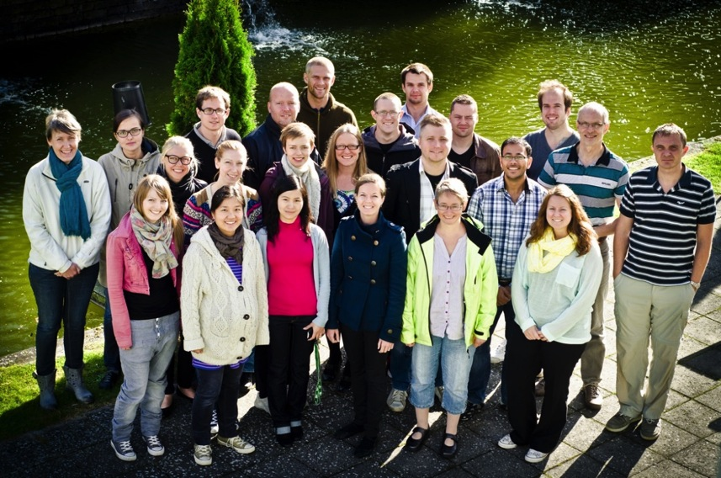


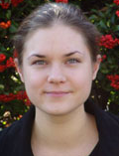
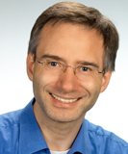
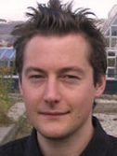
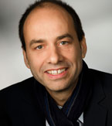
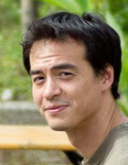
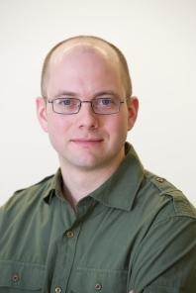

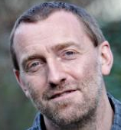

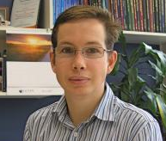
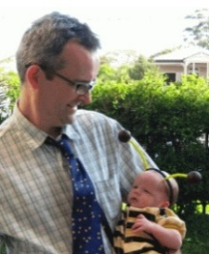

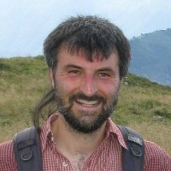

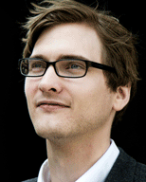

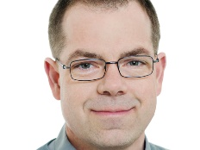


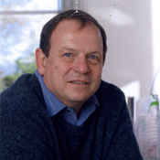


Acknowledgements
slides: goo.gl/xxxxx
@MadsAlbertsen85
Per H. Nielsen
Søren M. Karst
Rasmus H. Kirkegaard
Simon J. McIlroy
goo.gl/ohCVPg
University of Vienna
C. Dorringer
H. Daims
A. Loy
M. Wagner
F. Moeller
J. Neufield
L. Sauder
M. Kuhl
L. Behrendt
G.W. Tyson
P. Hugenholtz
A. Schramm
M. Lund
K. Nelson
S. Ishii
S. Ishii
M. Sommer
C. Munch
T. Rattei
Center for Microbial Communities | Aalborg University

